Slide 1
Master Thesis: Alzheimer Prediction
Fraj Yassine Lakhal
Munich, 3. December 2025
Notes:
I have a bold plan for the thesis but I think it is feasible

Slide 2
Motivation

Slide 3
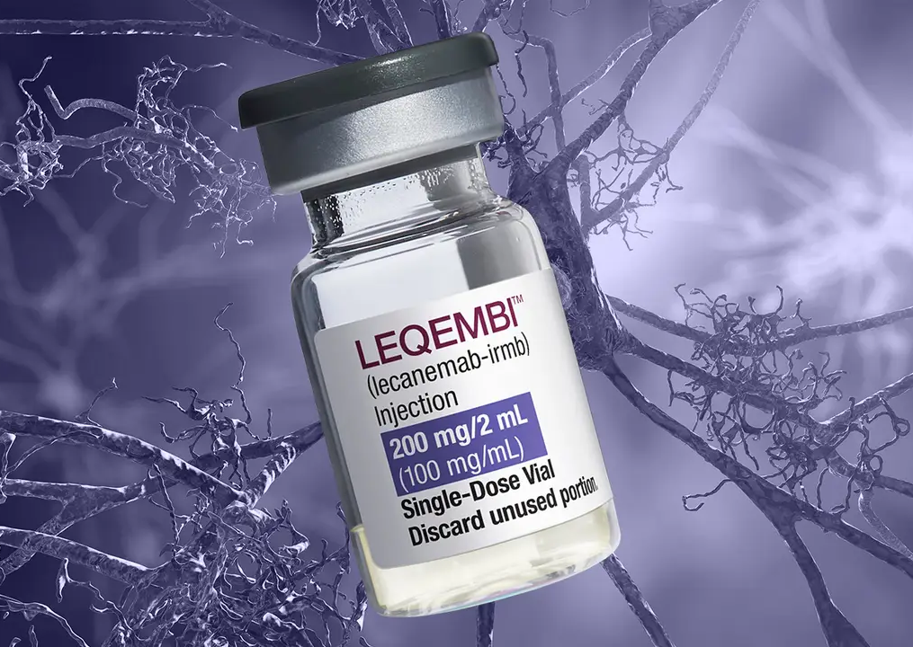
Alzheimer’s Disease Modifying treatment
Lecanemab approved for prescription on 15. April in Germany
Diagnosis is no longer just about memory tests; it now requires biological proof of Alzheimer's via biomarkers.
Approved for Early AD (Mild Cognitive Impairment or Mild Dementia)
It clears amyloid plaques to slow cognitive decline by ~27%. It does not restore lost memory; it preserves what is left.

Slide 4
Current Paradigm
1. Cognitive test: e.g., MOCA or MMSE
If you score below a certain threshold
(e.g., <26/30 on MOCA)
2. Blood test: Plasma p-tau217
radioactive tracer amyloid plaques
Highly suspicious for Alzheimer’s. The patient moves to the "Gold Standard" confirmation required for insurance and treatment approval.
3. Scans
Amyloid PET Scan: radioactive tracer amyloid plaques.
or
CSF Analysis (Lumbar Puncture): Spinal fluid is drawn to measure the ratio of amyloid/tau proteins.
Notes:
1) If you report memory issues, a Primary Care Physician (PCP) will perform a short cognitive test
2) How it works: It detects phosphorylated tau protein in the blood, which correlates 90-95% with amyloid plaque buildup in the brain.

Slide 5
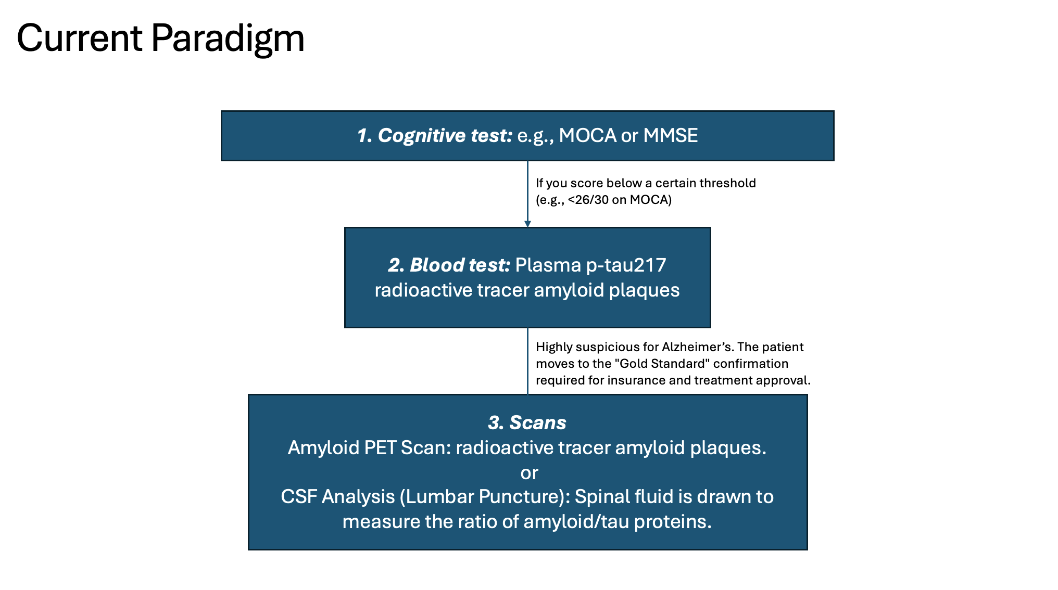
Several Issues: 1. Functional "Collapse" Precedes Structural Atrophy 2. Burdensome for elderly patients.

Slide 6
Several Issues: 1. Functional "Collapse" Precedes Structural Atrophy 2. Burdensome for elderly patients. Can we identify functionally vulnerable patients early on?

Slide 7
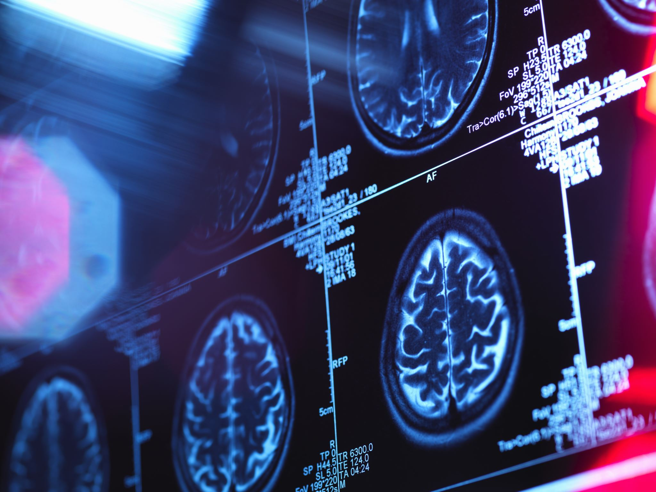
Why combine with deep learning?
A human radiologist cannot "see" functional connectivity in raw data.
A DL model (e.g., a Graph Neural Network) can identify non-linear disruptions in the Default Mode Network (DMN), often years before atrophy is visible on T1 scans1.
1 Xue, C., Yuan, B., Yue, Y., Xu, J., Wang, S., Wu, M., Ji, N., Zhou, X., Zhao, Y., Rao, J., Yang, W., Xiao, C., & Chen, J. (2019). Distinct Disruptive Patterns of Default Mode Subnetwork Connectivity Across the Spectrum of Preclinical Alzheimer’s Disease. Frontiers in Aging Neuroscience, 11. https://doi.org/10.3389/fnagi.2019.00307
Notes:
DMN stands for active regions when a person is not focused on the outside world

Slide 8
SoTA

Slide 9
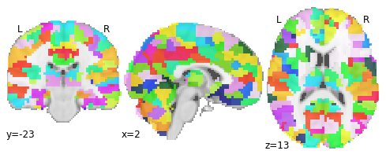
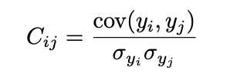
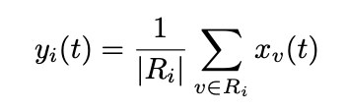

Usual Workflow for fMRI Preprocessing
1. ATLAS Parcellation
e.g. Harvard Oxford
2. Compute mean at time t
3. Pearson Correlation
Notes:
We end up with a symmetric N×N matrix where N is the number of ROIs

Slide 10
Theoretical Background

Slide 11
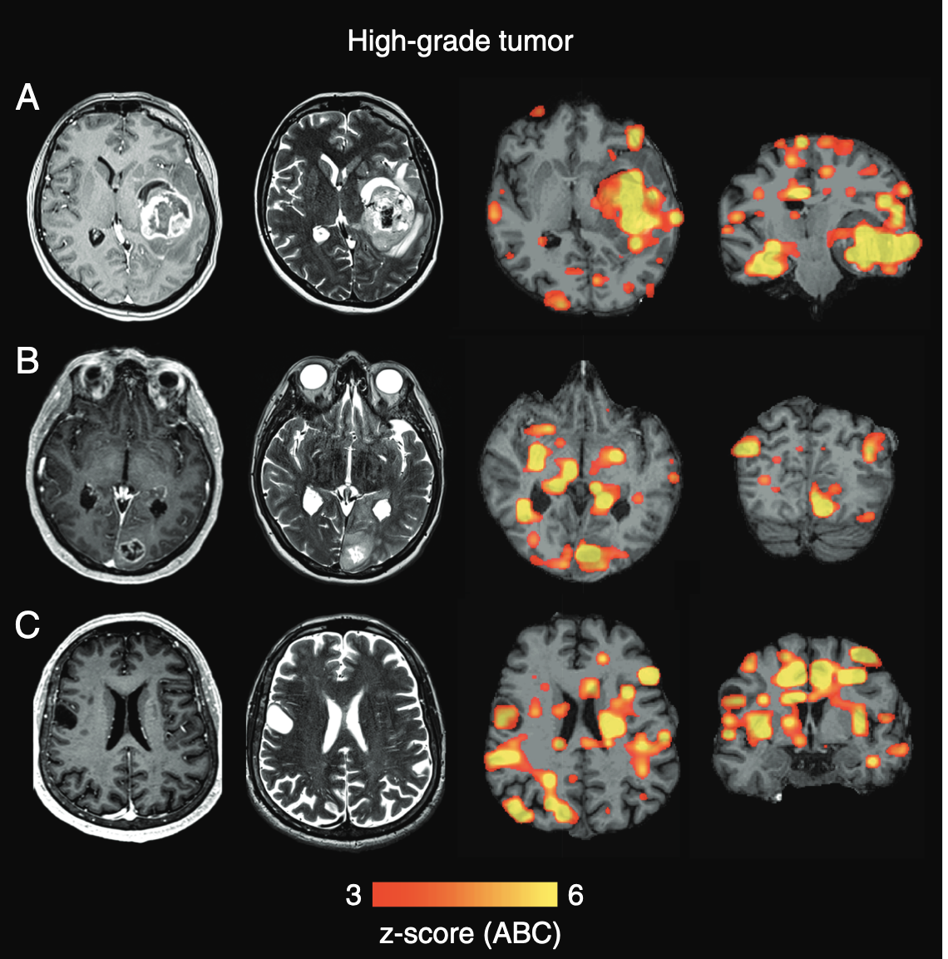
Theoretical Framework: fMRI as a Reliable Method for Brain Pathologies
(Stoecklein et al., 2020)
Find damage beyond the Lesion:
abnormalities in functional connectivity could be detected not only adjacent to the visible lesion but also in distant brain tissue, even in the contralesional hemisphere.
Define imaging markers to quantify disease Aggressiveness:
ABI* showed a close correlation with the aggressiveness of the tumor: correlates with MOCA tests, IDH Mutation Status and WHO Grade (Pathological Severity)
Feasibility:
fMRI sequences can be "tacked onto a clinical routine MRI scan without major modification to the scanning procedure," and the post-analysis can be done automatically
*quantitative imaging marker, quantifies whole-brain functional connectivity damage
(Stoecklein et al., 2020)
Stoecklein VM, Stoecklein S, Galiè F, Ren J, Schmutzer M, Unterrainer M, Albert NL, Kreth FW, Thon N, Liebig T, Ertl-Wagner B, Tonn JC, Liu H. Resting-state fMRI detects alterations in whole brain connectivity related to tumor biology in glioma patients. Neuro Oncol. 2020 Sep 29;22(9):1388-1398. doi: 10.1093/neuonc/noaa044. PMID: 32107555; PMCID: PMC7523460.

Slide 12
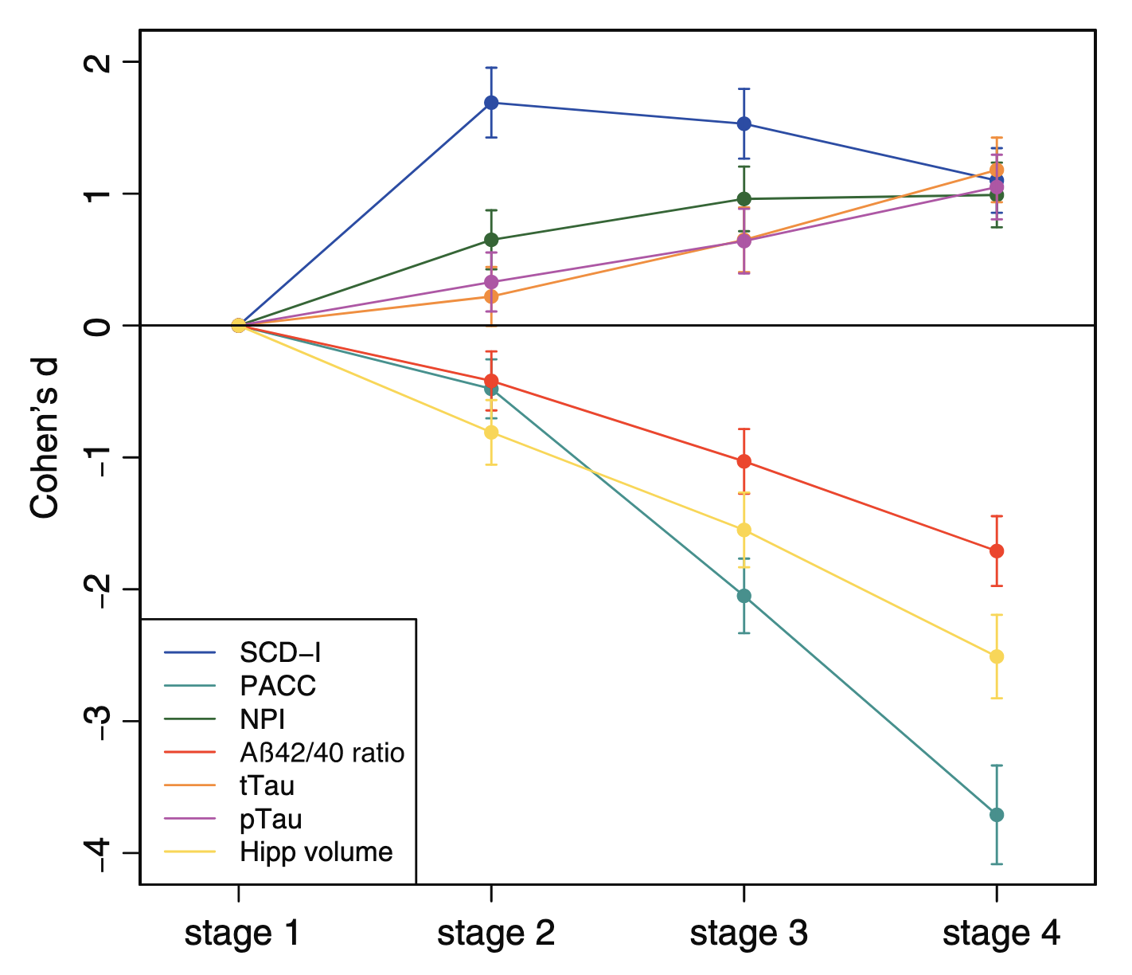
Theoretical Framework: MCI and The Alzheimer’s Disease Continuum
(Jessen et al., 2023)
AD Continuum is defined:
Stage 1 (asymptomatic, A+ Controls)
→ Stage 2 (SCD-A+)
→ Stage 3 (MCI-A+)
→ Stage 4 (DAT-A+)
Cognitive and Aß define the AD Continuum:
Preclinical Alzheimer's Cognitive Composite (PACC5) drastic cognitive decline as the disease progresses
Aβ positivity (A+) based on the Aβ42/Aβ40 ratio cut-off to define all cases
(Jessen et al., 2023)
Jessen F, Wolfsgruber S, Kleineindam L, Spottke A, Altenstein S, Bartels C, Berger M, Brosseron F, Daamen M, Dichgans M, Dobisch L, Ewers M, Fenski F, Fliessbach K, Freiesleben SD, Glanz W, Görß D, Gürsel S, Janowitz D, Kilimann I, Kobeleva X, Lohse A, Maier F, Metzger C, Munk M, Preis L, Sanzenbacher C, Spruth E, Rauchmann B, Vukovich R, Yakupov R, Weyrauch AS, Ziegler G, Schmid M, Laske C, Perneczky R, Schneider A, Wiltfang J, Teipel S, Bürger K, Priller J, Peters O, Ramirez A, Boecker H, Heneka MT, Wagner M, Düzel E. Subjective cognitive decline and stage 2 of Alzheimer disease in patients from memory centers. Alzheimers Dement. 2023 Feb;19(2):487-497. doi: 10.1002/alz.12674. Epub 2022 Apr 22. PMID: 35451563.
Notes:
DAT: Dementia of the Alzheimer's Type
A+: amyloid positive

Slide 13
Latent Vector Study

Slide 14
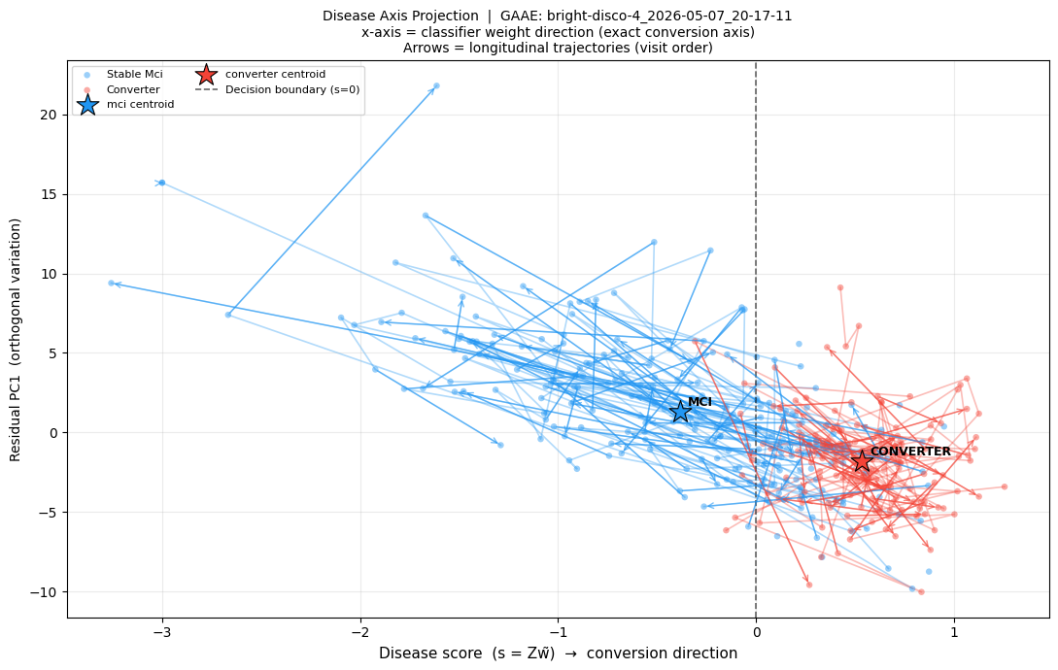
Evaluating the GAAE Latent Vector (Disease Progression)
Each fMRI connectivity matrix is encoded by the frozen GAAE into a 64-dimensional latent vector via mean-pooling over node embeddings
All latent vectors are z-standardised across the training set before any downstream analysis
A L2-regularised logistic regression is fitted on the standardised embeddings to classify MCI-stable vs. converter
→ the resulting weight vector w̃ ∈ ℝ⁶⁴ defines the disease axis: the linear direction in latent space most predictive of conversion
Every scan is projected onto this unit-normalised axis to yield a scalar disease score s = z · ŵ, where positive values indicate proximity to the converter class and negative values to stable MCI

Slide 15
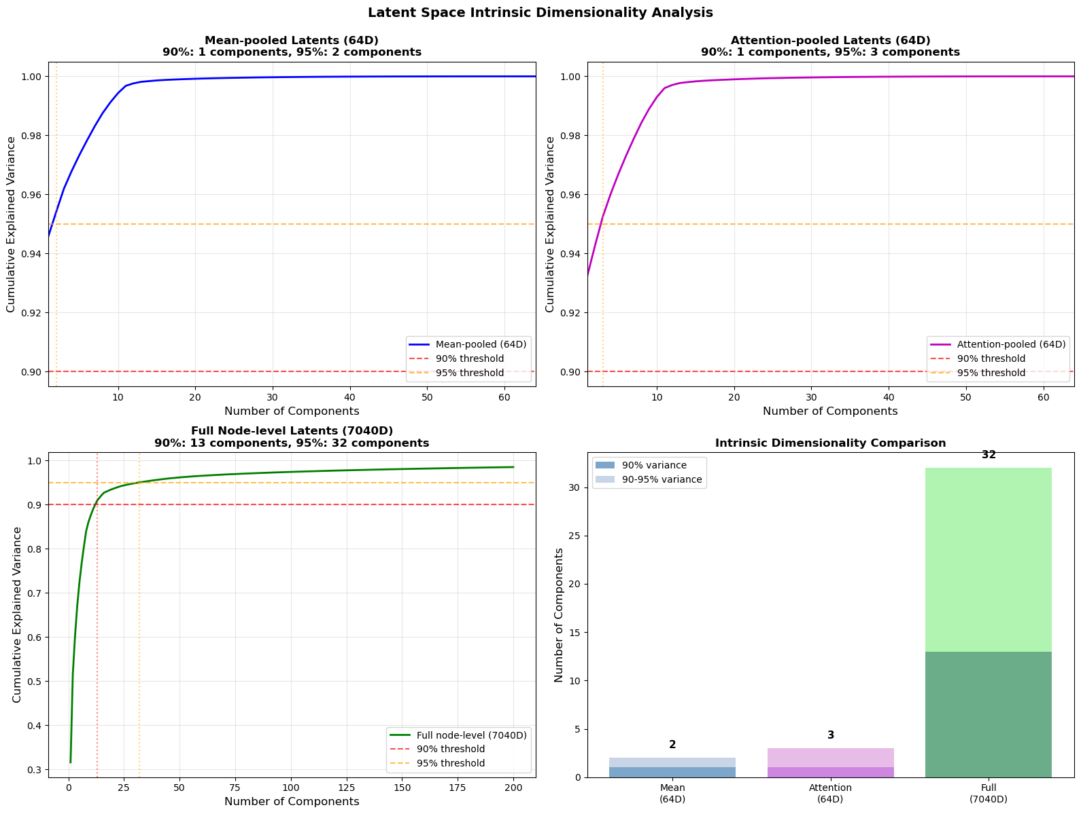
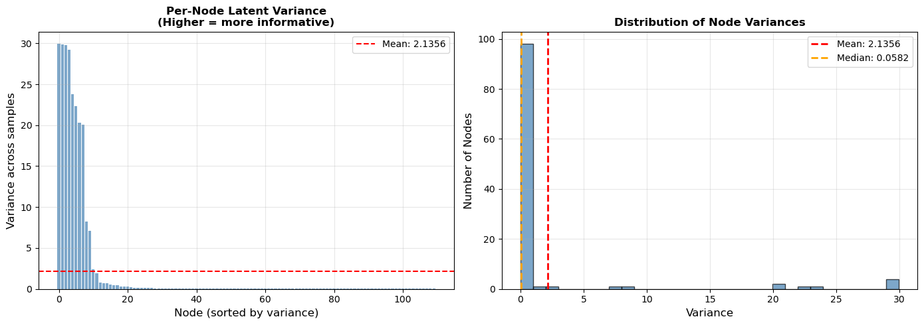
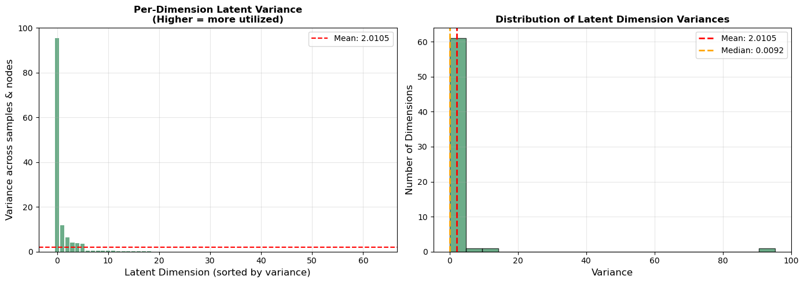
Pretrained Model: Latent Vector Study
Encoder Trained on All Cohorts

Slide 16
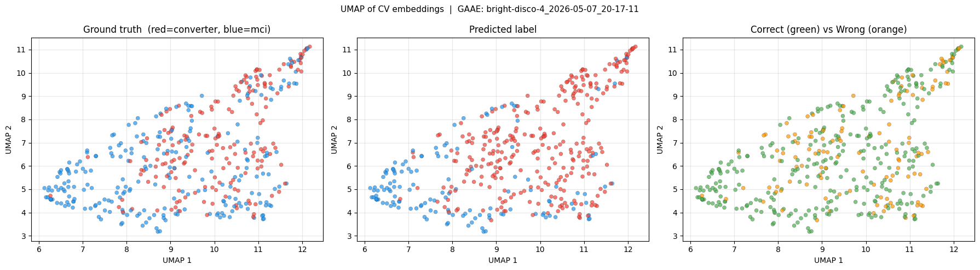
Evaluating the GAAE Latent Vector (Predictions in UMAP)
Using Logistic Regression

Slide 17
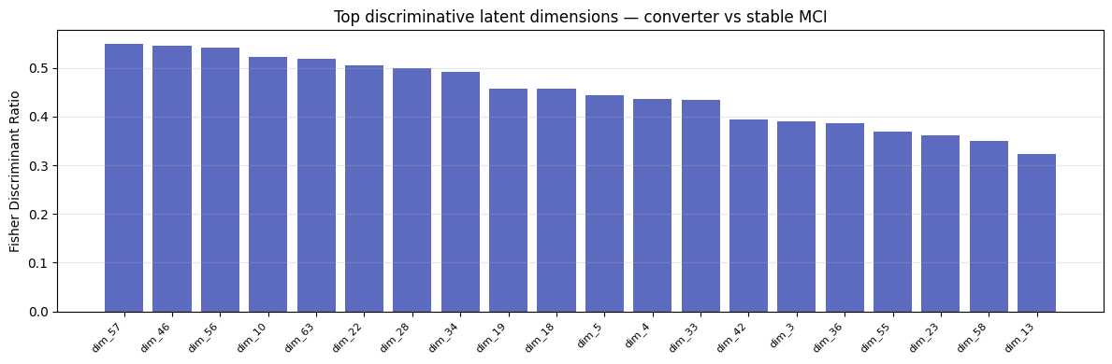

Slide 18
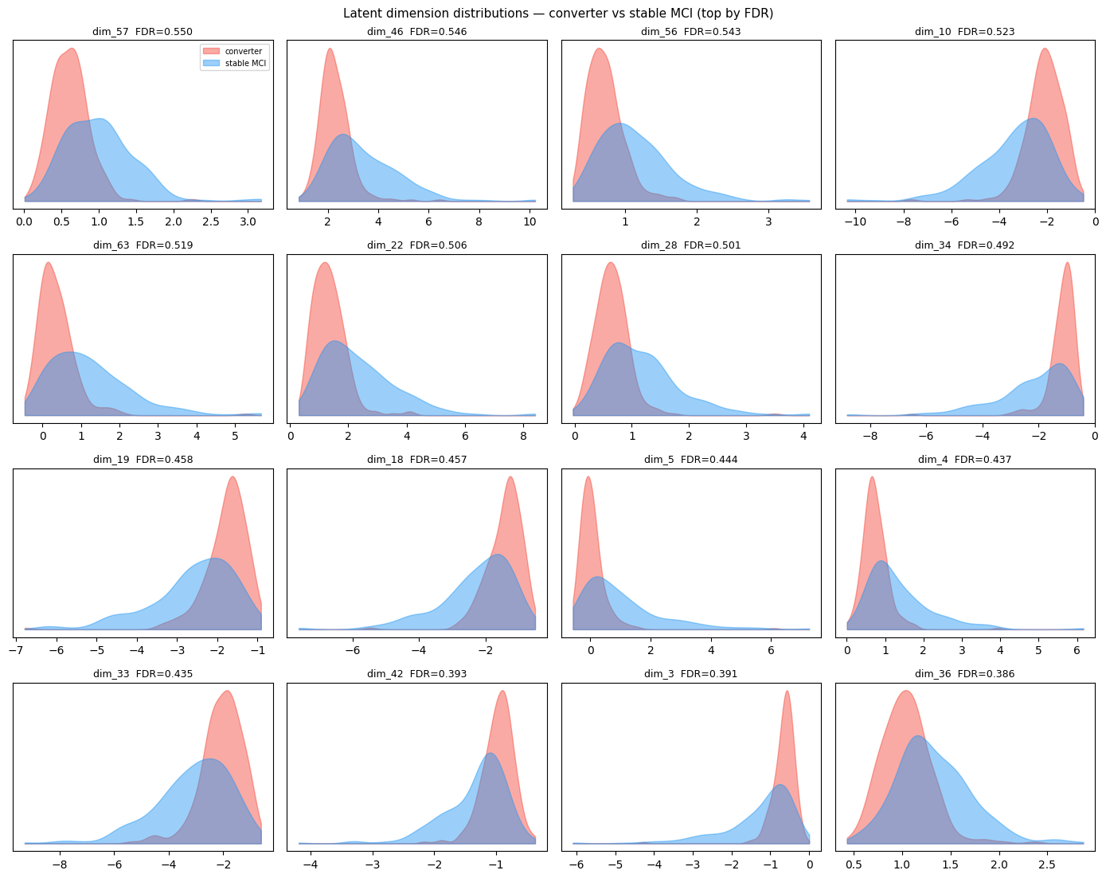

Slide 19
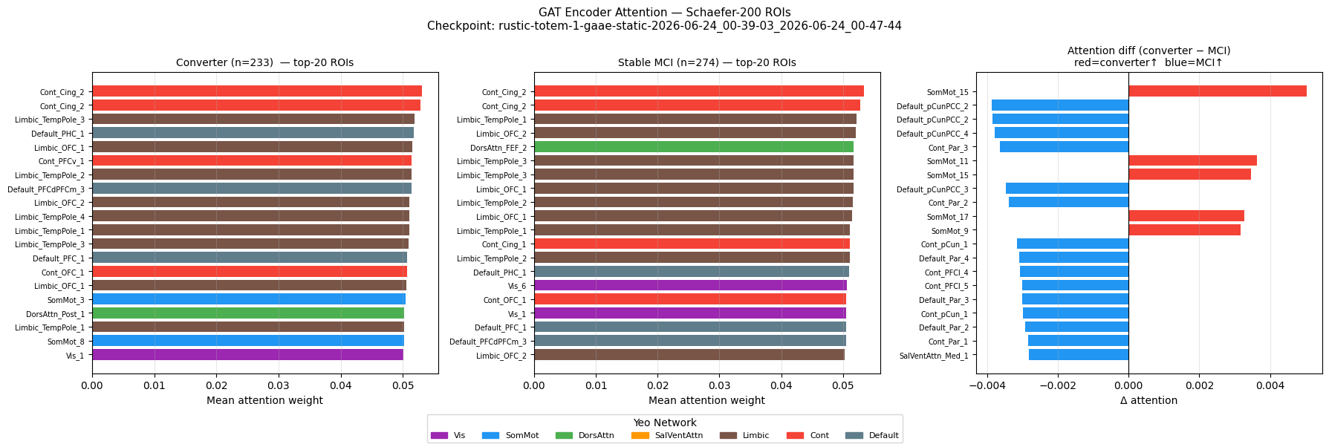

Slide 20
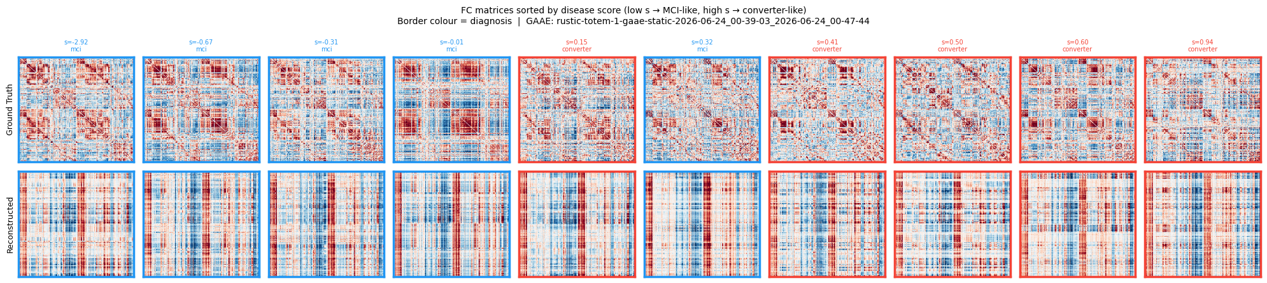

Slide 21
VAE

Slide 22
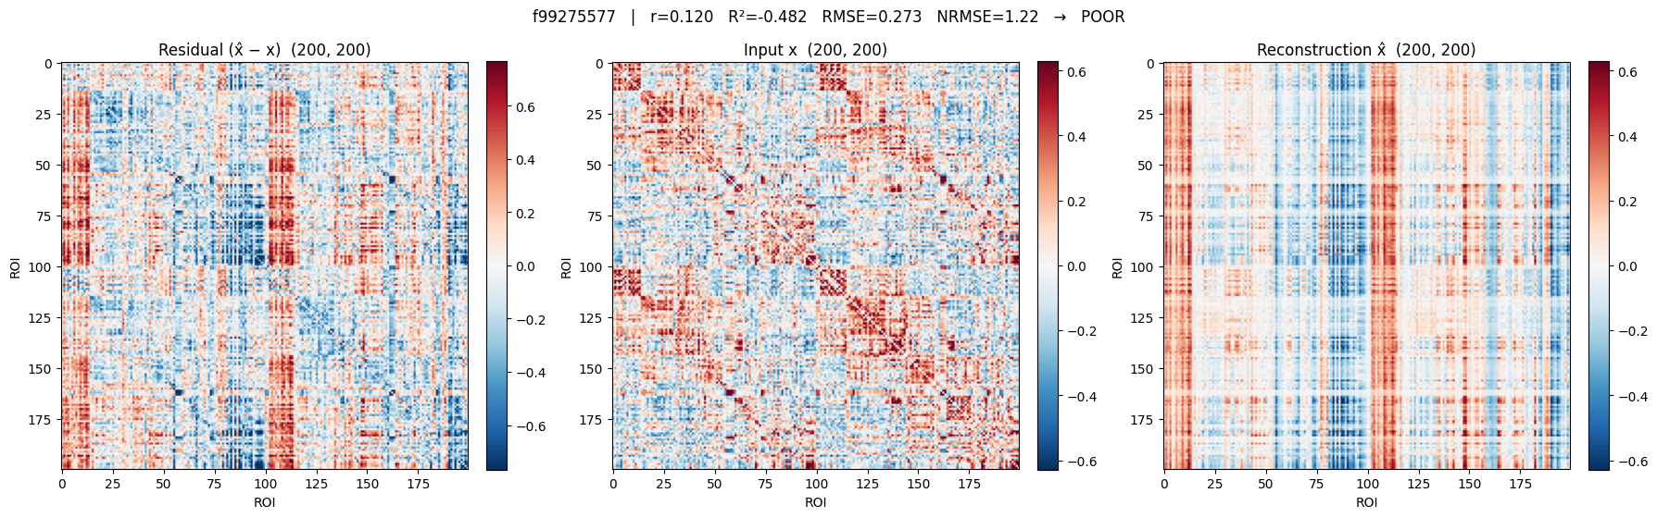
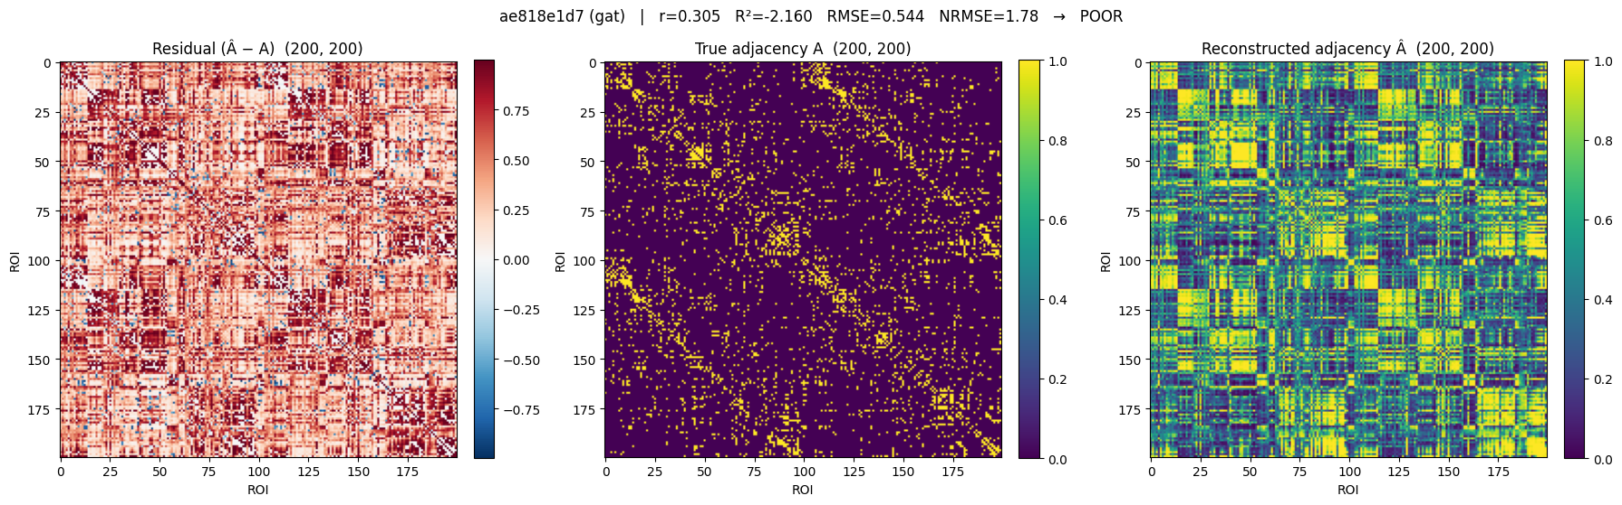
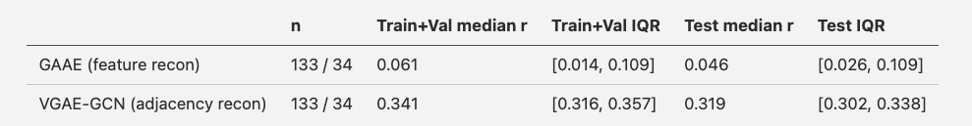
Most Recent Results
Moving to a VAE for the GAAE (Pretext model)
TODO 2: Check if the Pretext model even helps the classifier, so how the performance of the classifier looks like without it
Notes:
Go through the new models? - Rational behind the GRU (Longitudinal Data not too long) and the VGAE (64 latent vector dimensions were not enough to reconstruct the fmri)?
- Rationale behind using tangent space

Slide 23
Noise Perturbated Input

Slide 24
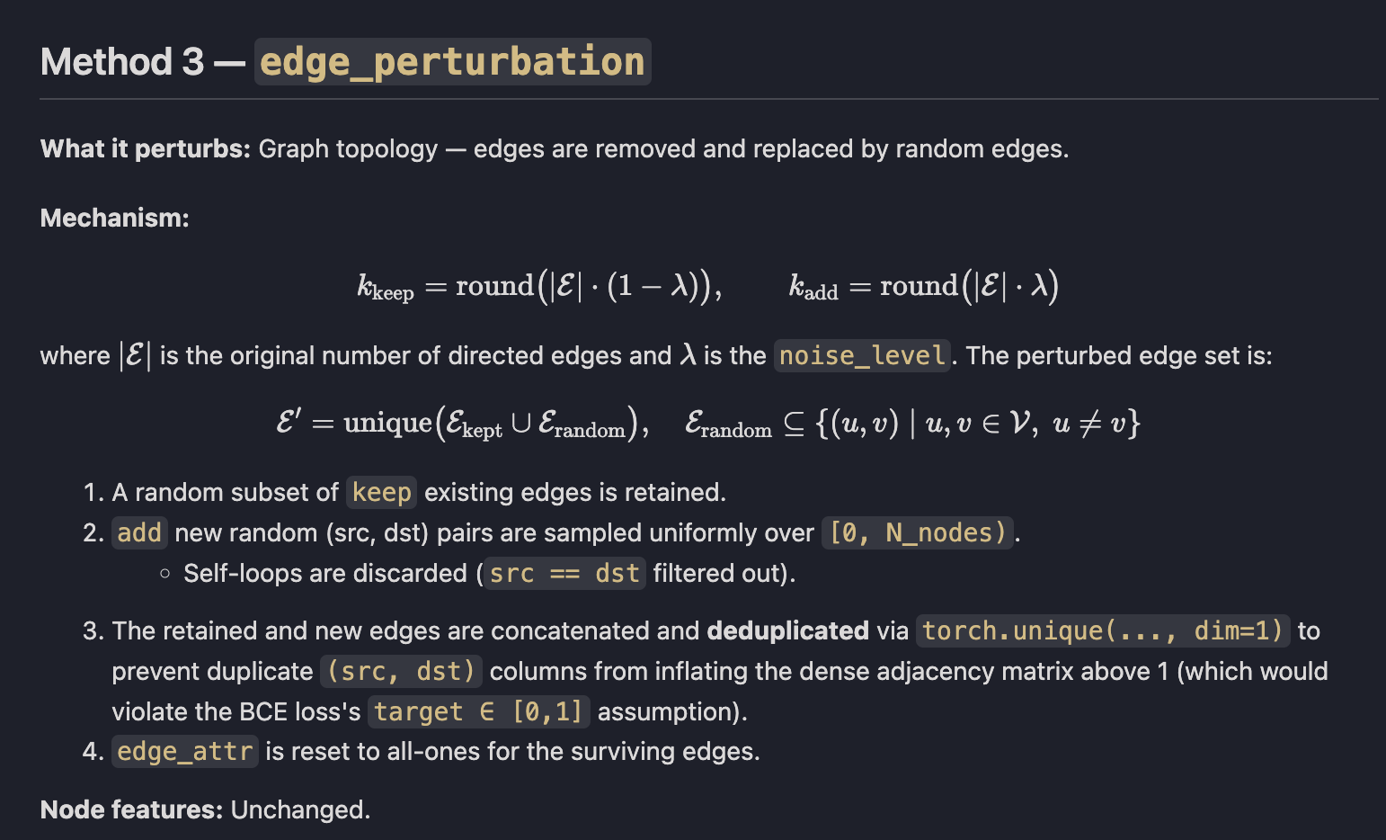
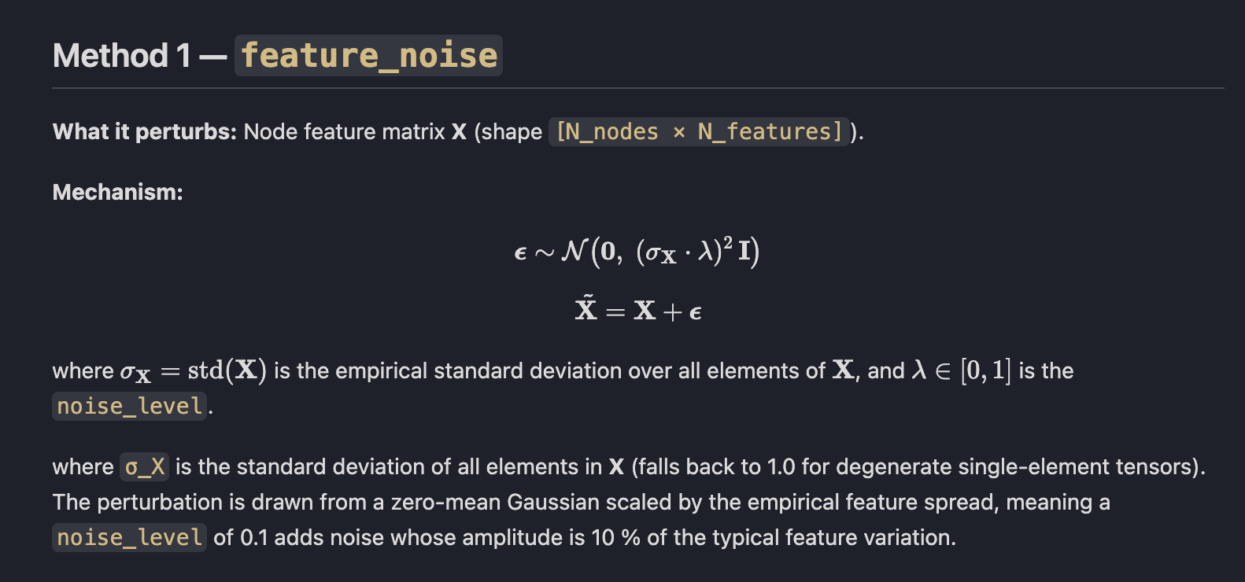
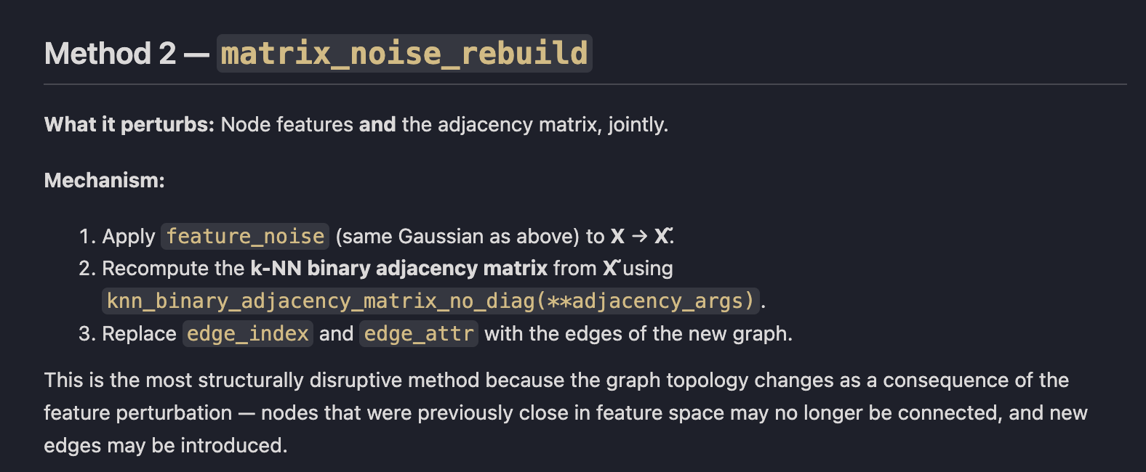
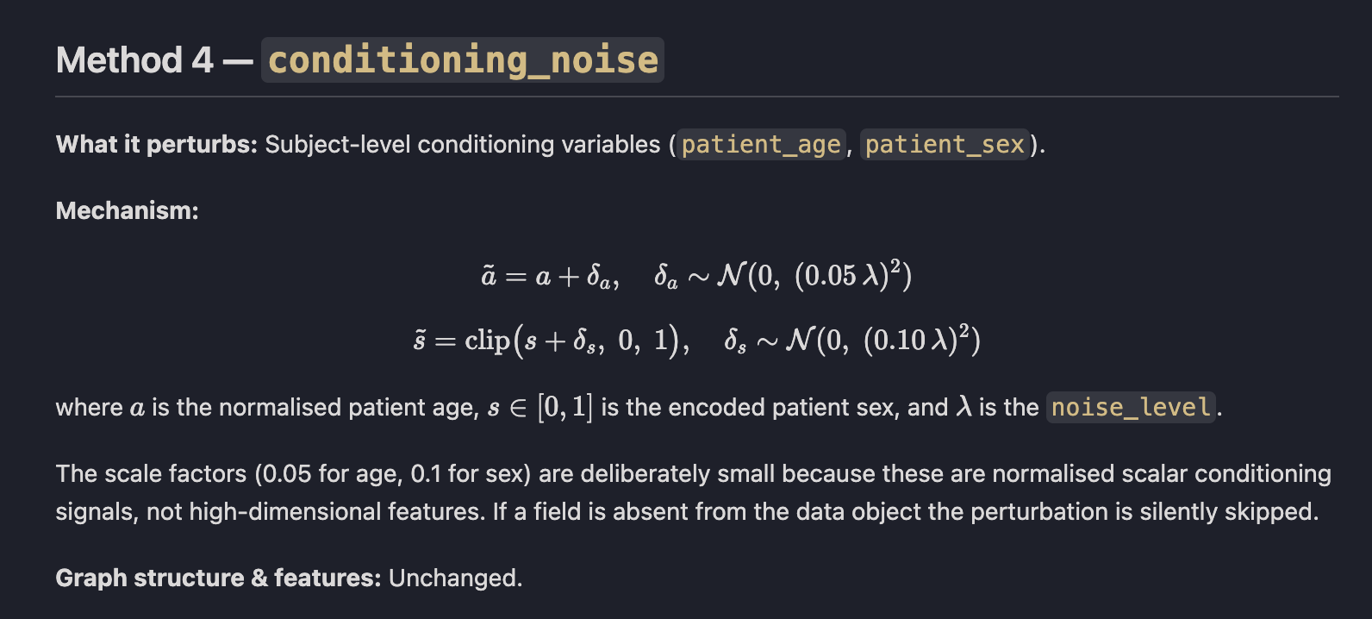

Slide 25
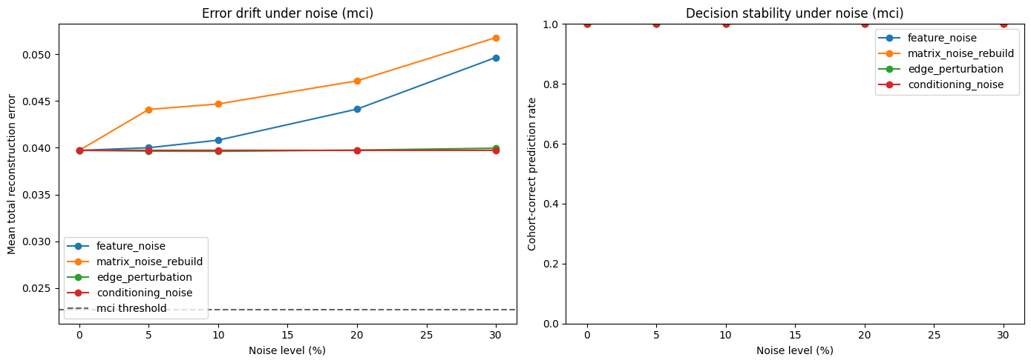
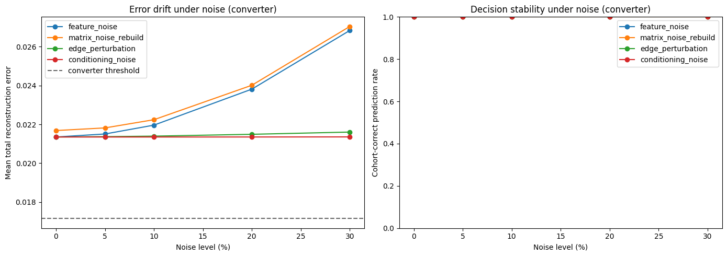

Slide 26
LSTM / GRU

Slide 27
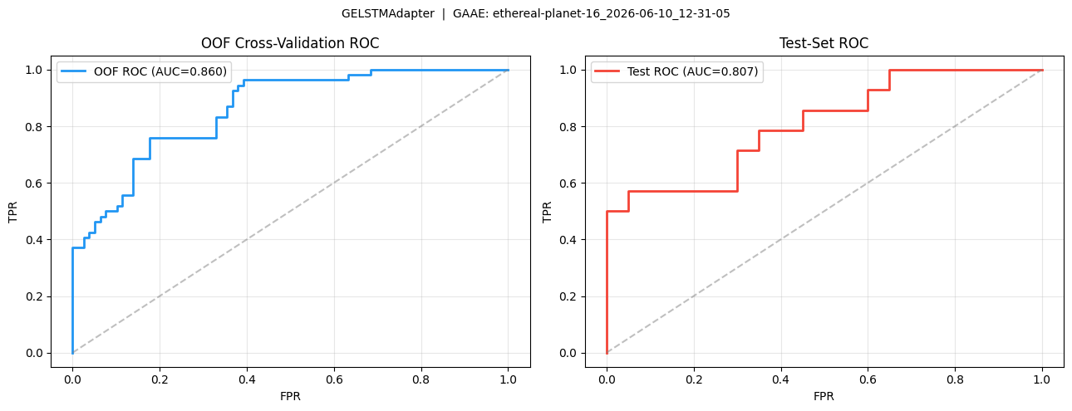
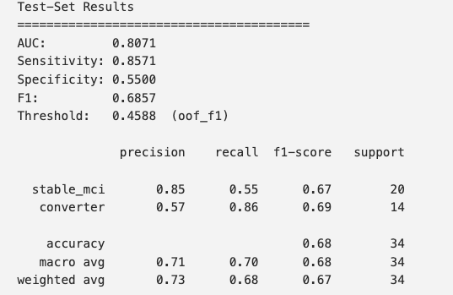
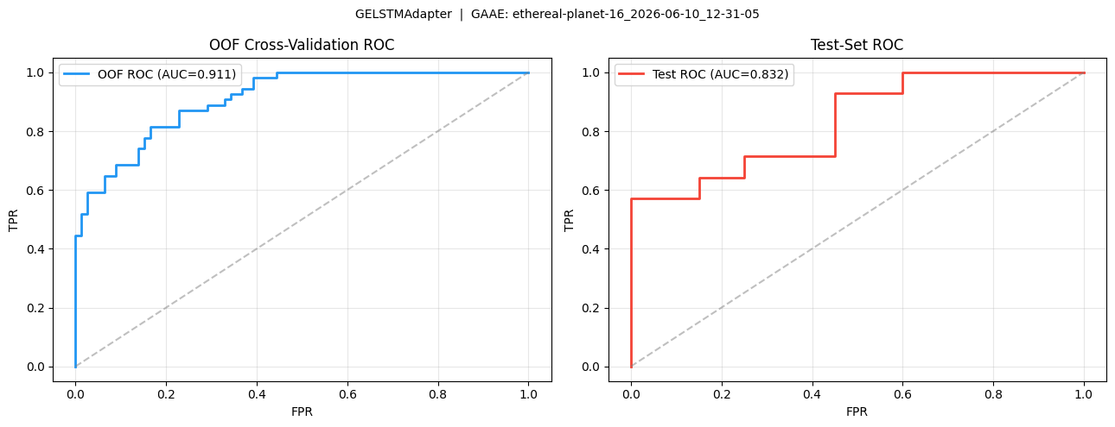
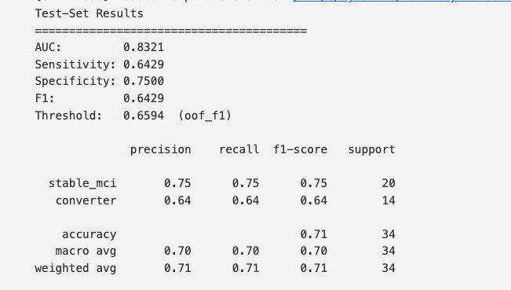
Most Recent Results
LSTM vs GRU
GRU perform in general better on shorter longitudinal than LSTMs data
Notes:
Go through the new models? - Rational behind the GRU (Longitudinal Data not too long) and the VGAE (64 latent vector dimensions were not enough to reconstruct the fmri)?
- Rationale behind using tangent space

Slide 28
AUC on BRAIN ROIs

Slide 29
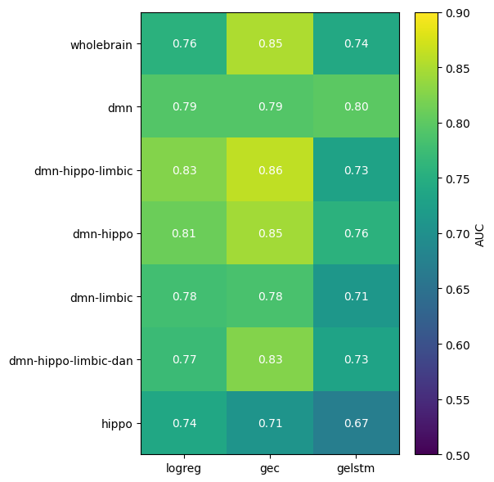
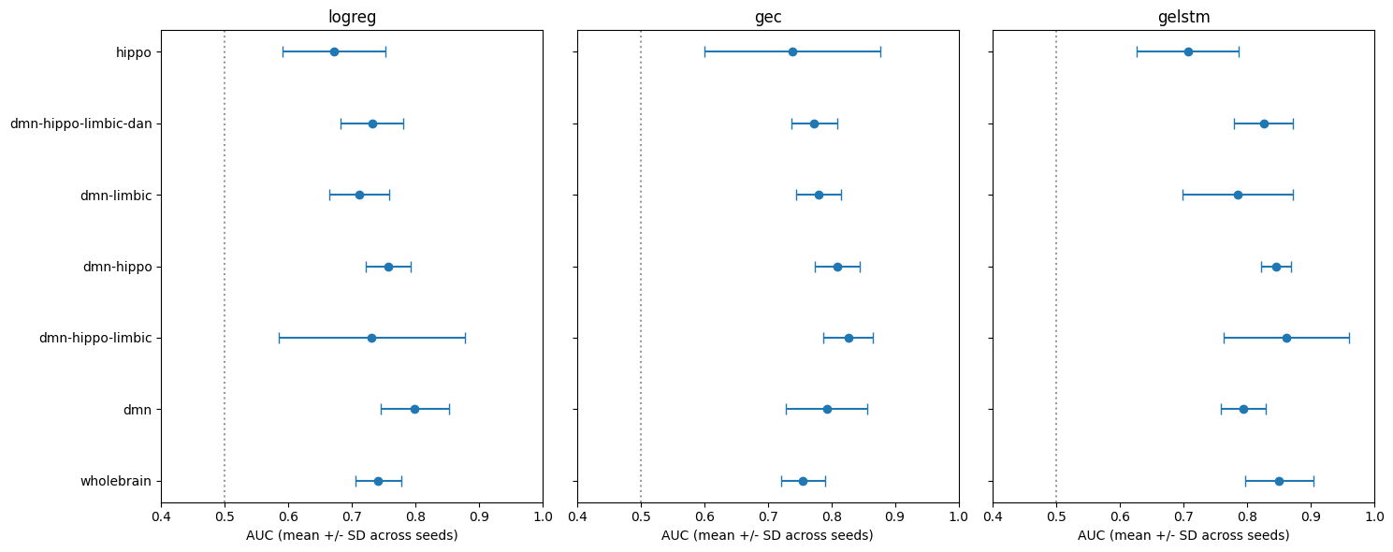
Heatmap - region x model AUC
Forest plot - AUC per (model, region)

Slide 30
SCANNER/SCANNING PROCEDURE DRIFT

Slide 31
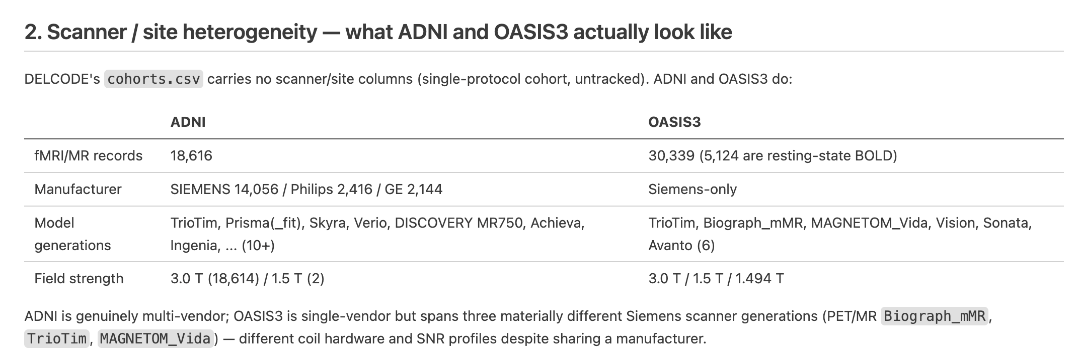

Slide 32
